Slide 1
Capstone Project
Play Store App Review Analysis
By
Abhishek Jain
Khushboo chaurasiya
Kalpita Malviya
Dheeraj gedam
Data Science Trainee, AlmaBetter

Slide 2






WHY ANALYZE THE GOOGLE PLAY STORE?
Mobile App Market is set to grow 20% by 2023
Android Apps comprise 90% of the Mobile App Market
What makes an App popular? Can we predict how popular it’s going to be?
What are some interesting patterns in user behavior related to app usage & feedback?

Slide 3


Introduction
Play store is an Android Market serves as the official app store for certified devices running on the Android Operating system. Developed and Operated by Google, launched on 6th March, 2012.
Approximately 3.48 million apps are in the Play store. Play store apps have their own features such as Ratings, Reviews, Size and more. From the problem statement given, we should analyze the given database and should come up with the key factors that increased the number of users, long term usage etc., the objective of this project is to deliver insights to understand customer demands better and thus help developers to popularize the product.

Slide 4


Problem Statement
Problem Statement
Two datasets are provided, one with basic information (play store Data.csv and the other with user reviews (User Reviews.csv) for the respective app.
We must examine and evaluate the data in both datasets in order to identify the important characteristics that inﬂuence app engagement and success.
So, what factors inﬂuence an app's success?
An app is said to be successful if it has:
A high average user rating
A good number of positive reviews
A good number of monthly average users
High revenue per customer and so on.

Slide 5

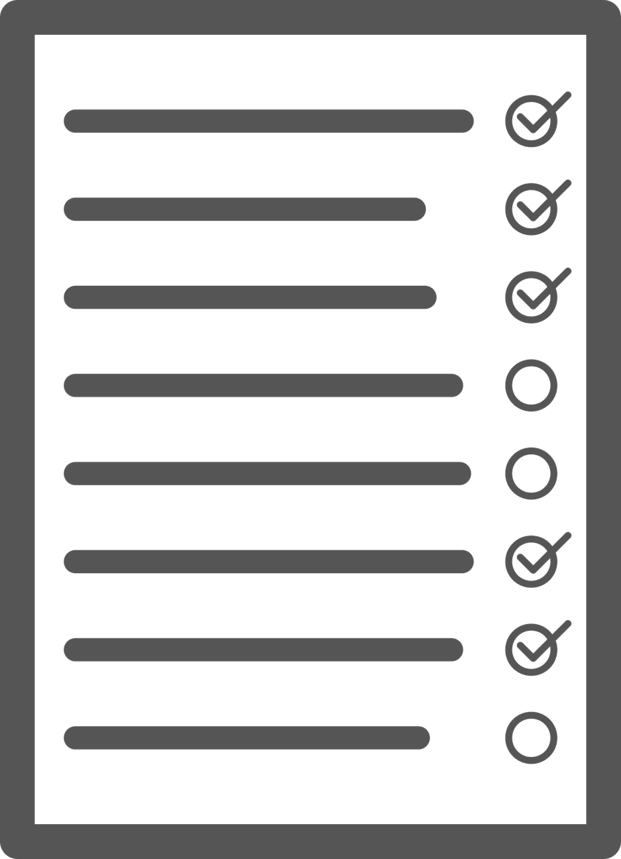
Agenda
Introduction
Exploring the database
Top 10 Highest rating Apps in google play store in terms of categories
Number of Application in terms of Category
Top 10 apps which has maximum downloads
Which 10 apps from the 'FAMILY' category are
having the lowest rating and highest rating.
Free and Paid Apps
Relation between app category and app price
Filter out "junk" apps
Sentiment analysis of user reviews
conclusion

Slide 6

Dataset Preparation
Loading the data sets: Two datasets, First Play store app
dataset and User Reviews dataset.
Import Libraries: NumPy, Pandas, Seaborn and Matplotlib
Data cleaning: Null values, Finding and removing Outliers, Removing duplicate data.
Data Imputation: Filling the missing categorical values with mode and numerical values with median. Conversion of price, installs, reviews into numerical values.
Exploratory Data Analysis: Analyzing the data sets to summarize their main characteristics using statistical graphics and data visualizations method.

Slide 7
1.App : This column Contains the name of the app for each observation. 2.Category : This column Contains Category to which the app belongs. 3.Rating : This column contains the average rating for the app. 4.Reviews : This column contains the number of reviews that the app has received on the play store. 5.Size : This column contains the amount of memory the app occupies on the device. 6.Installs : This column contains the number of times that the app has been downloaded and installed from the play store. 7.Type : This column contains the information whether the app is free or paid. 8.Price: If the app is a paid app, this column contains the data about its price. 9.Content Rating: This column contains the maturity rating of the app i.e. the age group of the audience for which it is suitable. 10.Genres: This column contains the data about to which genre the app belongs. Genres can be considered as a further division of the group of Category. 11.Last Updated: Contains the date on which the latest update of the app was released. 12.Current Version: Contains information on the current version of the app available on the play store. 13.Android Version: Contains information about the android versions on which the app is supported.
Attributes in Google Play store Data

Slide 8

Attributes in User reviews
App- Application name
Translated Review- User review
Sentiment- Positive/Negative/Neutral
Sentiment Polarity- Sentiment polarity score
Sentiment Subjectivity- Sentiment subjectivity score

Slide 9



OVERVIEW OF ANALYSIS
Data Cleaning
Data Exploration
Predictive Modeling
Understand the structure of the dataset and clean data before analysis
Uncover initial patterns, characteristics, and points of interest using visual exploration
Formulate a statistical model to forecast an outcome using relevant predictors

Slide 10
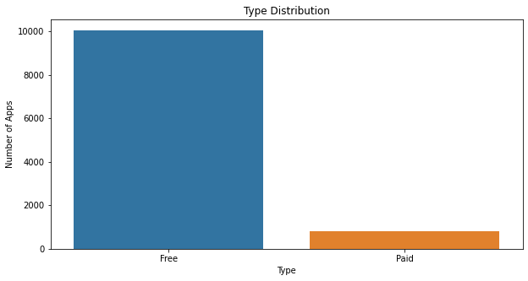
Paid apps v/s Free apps
When comparing the both plots, people are showing more interest on free apps like art & design. And The number of free apps are more than 10000
When it’s coming, commercial people are preferring apps like Business, communication and Personalization and the number of paid apps are less than free apps.

Slide 11
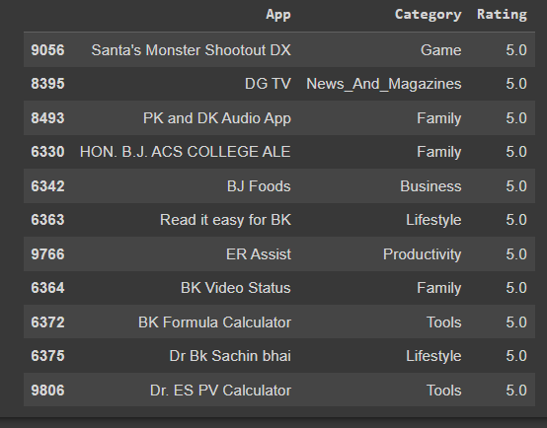
Top 10 Highest rating Apps in google play store in terms of categories
Categories like Games, Business, and Family are having comparatively more amount of apps count. We can see the data for our reference.

Slide 12
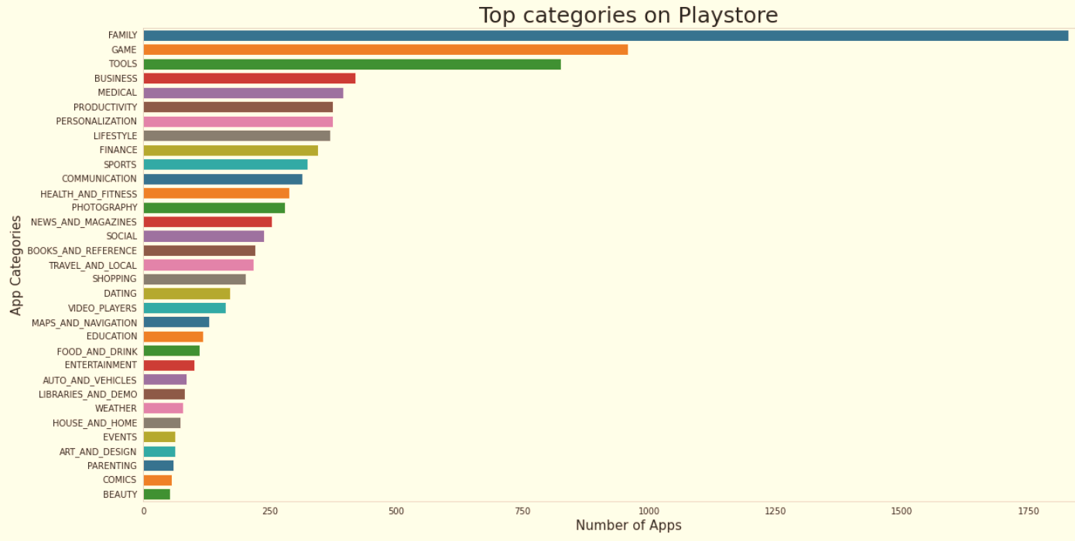
Count of Applications in each category
Family and Game apps have the
highest market prevalence. Surprising Tools, Business and Medical apps are also at the Top Count of applications.

Slide 13
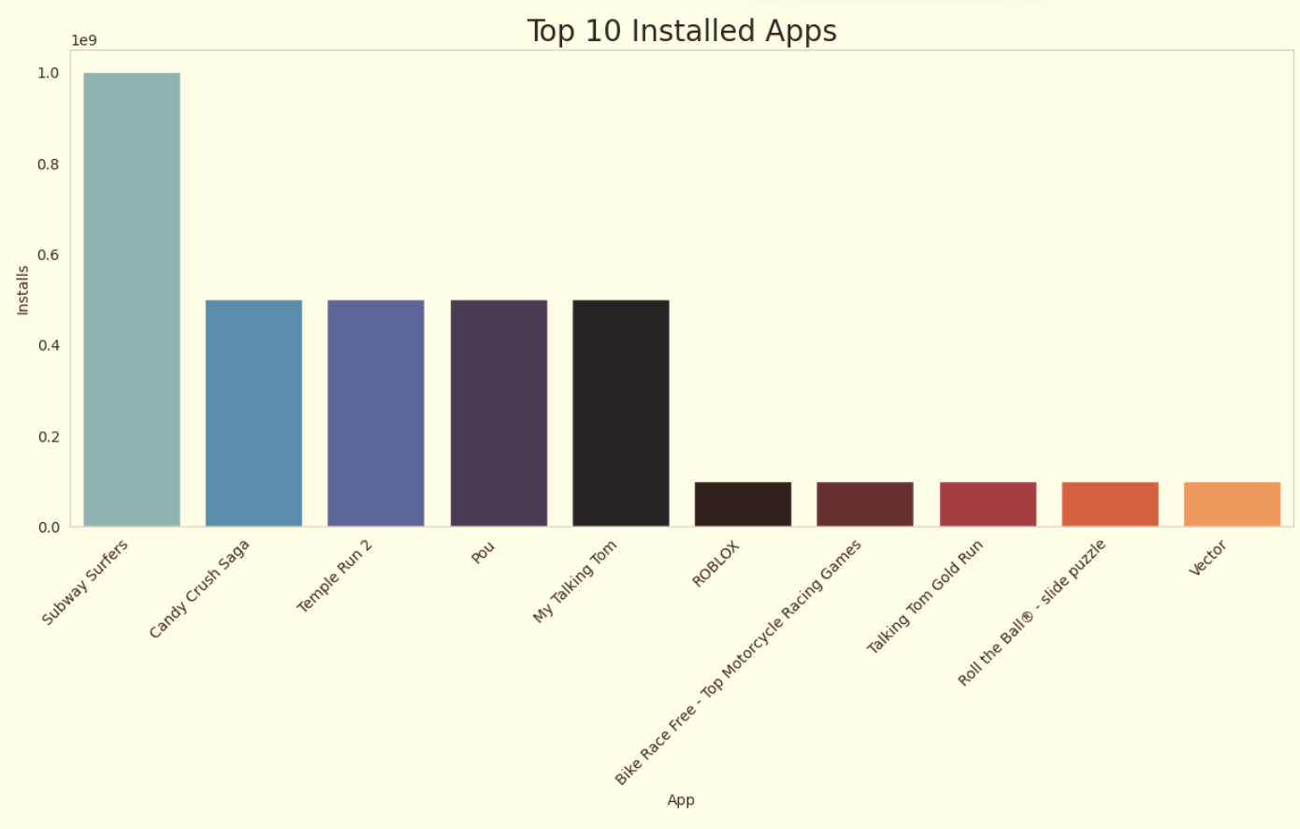
Top 10 installed apps in any category
This graph shows the top installed apps in the ‘Games’ category. Further looking into the play store reveals that these apps are light, casual, single player games.

Slide 14
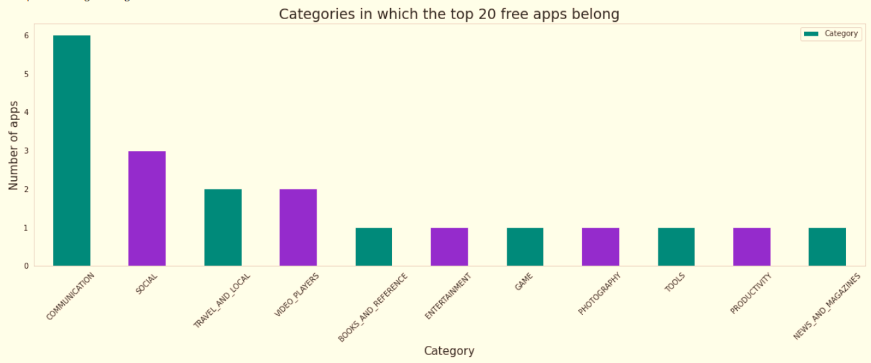
Top Free Apps
There are a total of 20 free apps with over one billion installs.
The top categories in which these apps fall are Communication(6), Social(3), Video Players(2), Travel and Local(2).

Slide 15
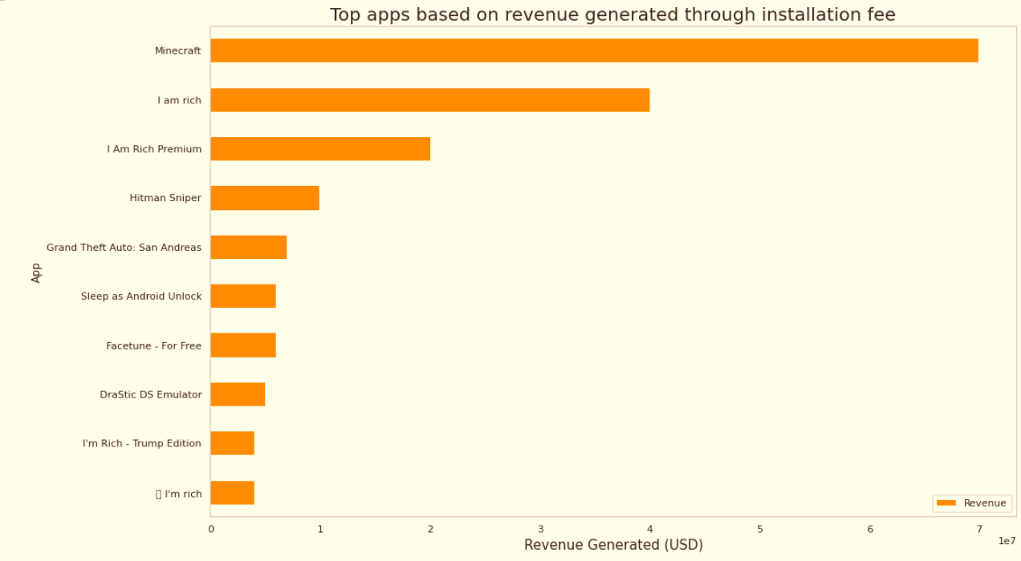
Top Paid Apps Based on Revenue Generated
Revenue generated is given by the formula:
Revenue = Installs * Price
Note that in this case, revenue refers to the money earned only from paid app installs.
The top categories in which these apps fall are Lifestyle(5), Family(5), and Game(4).
Minecraft, I am rich, and I am rich premium are the top paid apps based on revenue generated.
Minecraft is the only app that has over 10 M installs.

Slide 16
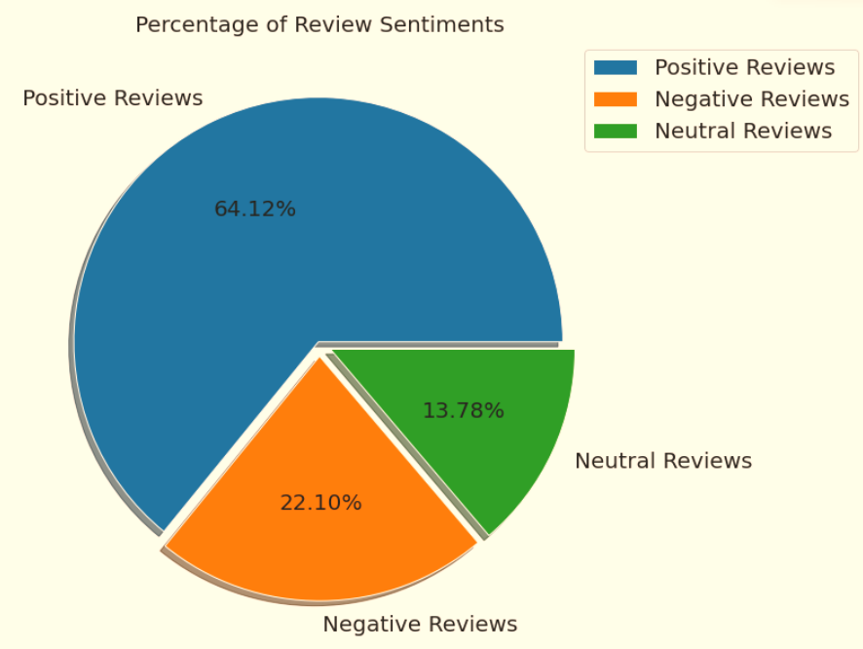
Percentage of Review Sentiments
The number of Unique Apps from Play store and User reviews merged dataset are 816.
From Sentiment column, 64% are Positive, 22% are Negative and 14% are Neutral values.

Slide 17
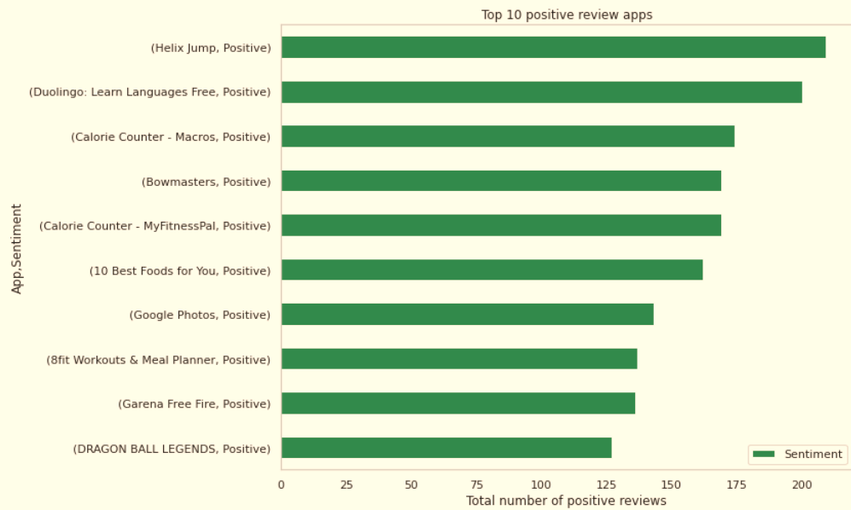
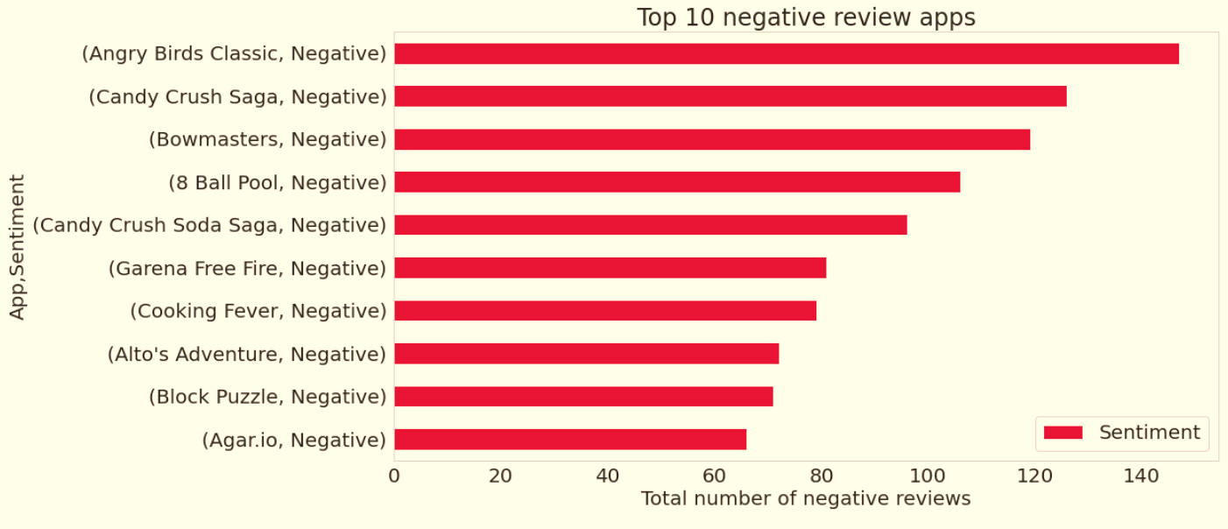
Positive and Negative Reviews
Angry Bird Classic is a app from merged dataset has highest 147 Negative sentiment count.
Helix Jump is a App from merged dataset has highest 209 Positive sentiment count.

Slide 18

Challenges Faced
Challenges Faced
Reading the dataset and comprehending the problem statement.
Examining the business KPIs for app development and devising a solution to the problem.
Handling the error, duplicate and NaN values in the dataset.
Designing multiple visualizations to summarize the information in the dataset and successfully communicate the results and trends to the reader.

Slide 19
Conclusion’s
After analyzing the dataset we have got answers to some of the serious & interesting facts which any of the android users would love to know.
a) Top 10 Highest rating Apps in google play store in terms of categories
b) Number of Application in terms of Category
c) Top 10 apps which has more downloads
d) Which 10 apps from the 'FAMILY' category are having the lowest rating and highest rating.
e) Free and Paid Apps
f) Relation between app category and app price

Slide 20


